Slide 1
INSURANCE ANALYTICS PROJECT
Insurance Policy Analytics Dashboard
End-to-End Analysis Across Excel, SQL, Power BI & Tableau
Excel
SQL
Power BI
Tableau
5,000 Customers • 5,000 Policies • 5,000 Claims Records
Team :- • Guvva Mahesh • Shaik Asifa Kousar • P Shirisha • B.Sai Ruthwik • Kola Shivani • Karan • Deva Jeevan Kumar Reddy

Slide 2
Domain: Insurance Analytics
Excel
SQL
Power BI
Tableau
Data cleaning, pivot analysis & KPI cards
Query-based KPI extraction & validation
Interactive dashboard & DAX measures
Visual analytics & trend storytelling

Slide 3
Agenda
01
Introduction & Project Goal
05
Power BI Dashboard Overview
02
Dataset Description & Schema
06
Tableau Dashboard Overview
03
Key Performance Indicators
07
SQL Queries
04
Excel Dashboard Overview
08
Conclusion & Recommendations

Slide 4
OVERVIEW
Introduction
This presentation walks through an end-to-end Insurance Policy Analytics project — built on customer, policy, claims, and payment data for 5,000 policyholders. The same set of 21 business questions is answered using four different tools: Excel, SQL, Power BI, and Tableau — showing how the same insight can be reached through different technical paths.
AT A GLANCE
5,000
Customers
5,000
Policies
Customer Demographics
₹25.1 Cr
Policy Performance
Total Claims
Claims Behaviour
4
Analytics Tools
Premium Trends

Slide 5
PURPOSE
Project Goal
Build a unified analytics view of the insurance policy book — spanning customer profile, policy issuance, claims activity, and premium trends — so that stakeholders can answer 21 core business questions consistently, regardless of which analytics tool they open.
Understand Customers
Track Policy Health
Monitor Premium Trends
Age, gender & demographic distribution across the policy book.
Active, lapsed & terminated policy performance by type.
Year-over-year premium growth and volatility.

Slide 6
DATA FOUNDATION
Dataset Description
Customer Information
Customer ID, name, gender, age, occupation, marital status, address.
Policy Details
Policy ID, type, coverage & premium amount, start/end date, status.
Claims
Claim ID, date, amount, status, reason, settlement date.
Payment History
Payment ID, date, amount paid, method, status.
Additional Fields
Agent ID, renewal status, discounts, risk score.

Slide 7
STRUCTURE
Data Schema
Policy Details acts as the central fact table, linked to four supporting tables through Policy ID and Customer ID.
Customer Information
Customer ID
Claims
Policy Details
Payment History
Policy ID
Fact table
Policy ID
Additional Fields
Policy ID

Slide 8
GROUNDWORK
Data Preparation & Cleaning
Before analysis, each tool's source connection was cleaned the same way to keep results comparable.
Remove blank columns
Fix data types
Validate relationships
4 unused columns in Policy Details & Claims (auto-generated, >99% null) were hidden.
Date columns (start, end, claim, settlement, payment) cast to proper Date type.
Customer ID and Policy ID joins checked across all 5 tables — no orphan rows found.
Handle expected nulls
De-duplicate
Bin age groups
1,555 blank Settlement Dates kept as-is — claims still Pending/Denied have none.
Row-level duplicate check run on every sheet — 0 duplicates found across 5,000 rows.
Custom 8-bucket Age Group field (<18 to 75+) built once, reused in every tool.

Slide 9
METRICS
Key Performance Indicators
21 core KPIs were defined across five categories, and answered consistently across all four tools.
Q2–Q6
Q7–Q10
Q11–Q14
Q15–Q18
Q19–Q22
Volume & Value
Policy Health
Demographics
Policy Mix
Premium Trend
Customers, policies, claims, avg. coverage & premium
Active %, status split, active:inactive ratio
Age group & gender participation
Policy type comparison & totals
YoY growth rate & policy-end trend

Slide 10

Excel Dashboard Overview

Slide 11
INSURANCE POLICY ANALYTICS DASHBOARD
Insurance companies generate large volumes of data related to customers, policies, claims, and premium payments. Analyzing this data helps organizations understand customer behavior, evaluate policy performance, monitor claims, and support better business decisions.
In this project, an Insurance Policy Analytics Dashboard was developed using Microsoft Excel, SQL, Power BI, and Tableau. A dataset containing 5,000 customer records, 5,000 policy records, 5,000 claim records, and payment history was analyzed to answer key business questions through data cleaning, KPI calculations, visualizations, and dashboards.
The objective of this project is to transform raw insurance data into meaningful insights that enable stakeholders to monitor policy performance, identify trends, compare customer demographics, and improve decision-making using different analytics tools.

Slide 12
Excel Dashboard 1 – Policy Overview

Slide 13
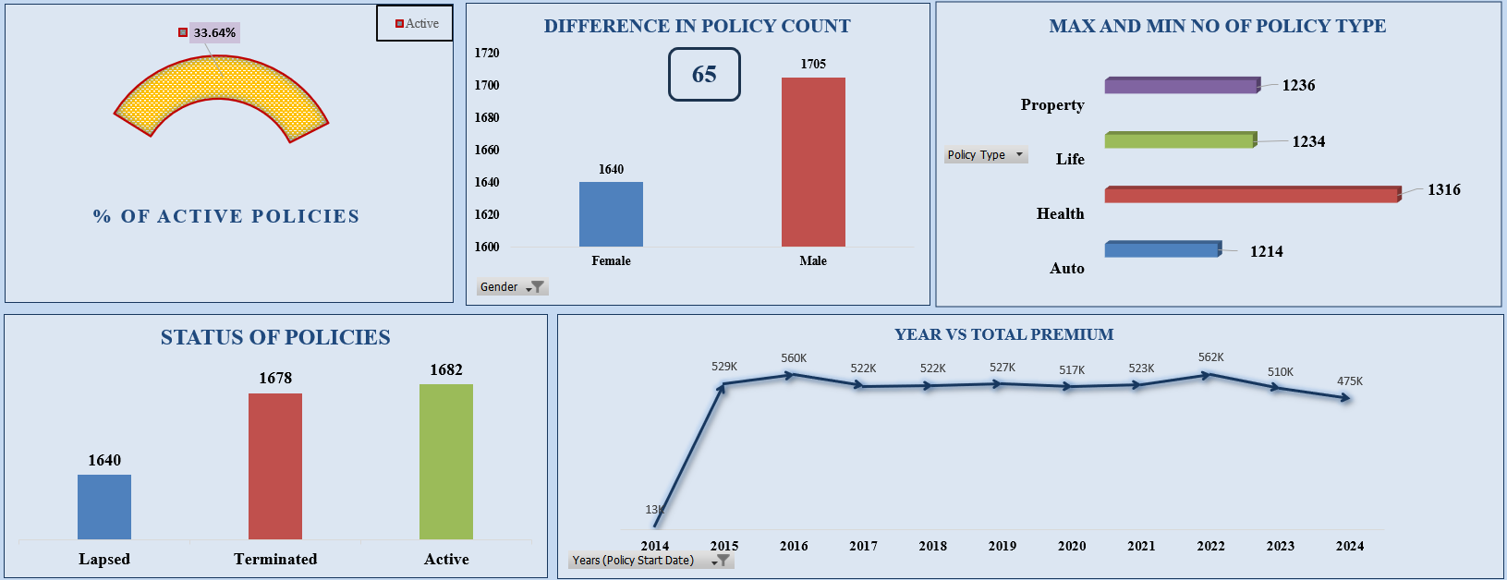
Excel Dashboard 2 – Premium & Policy Trend Analysis

Slide 14
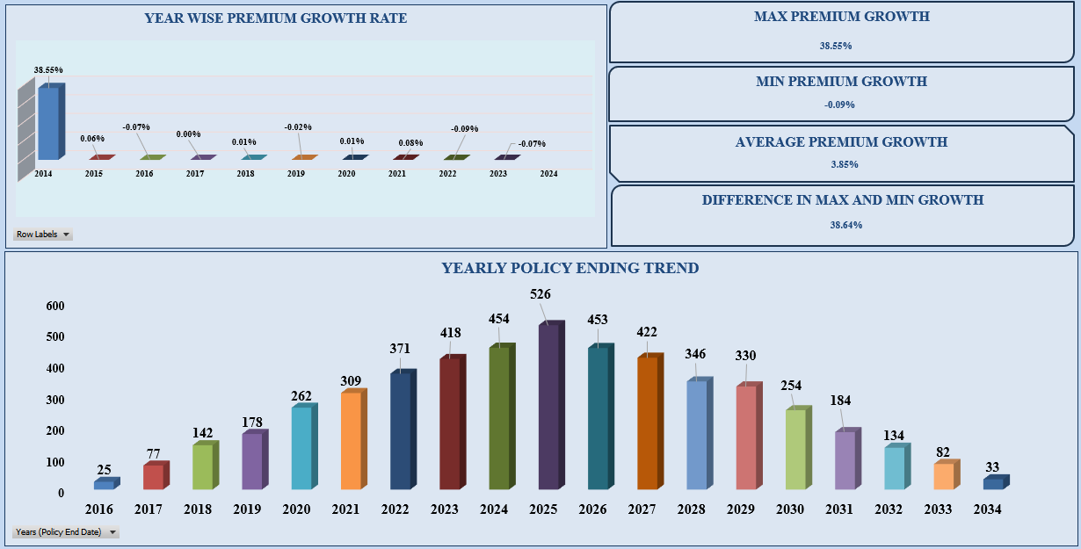
Excel Dashboard 2 – Premium & Policy Trend Analysis

Slide 15
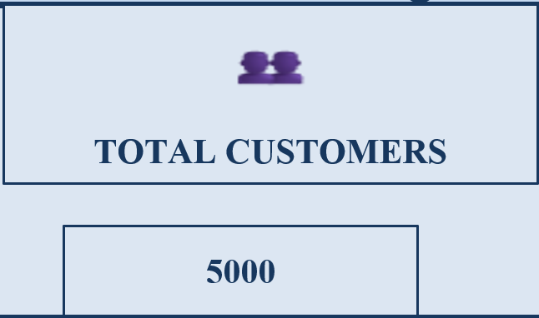
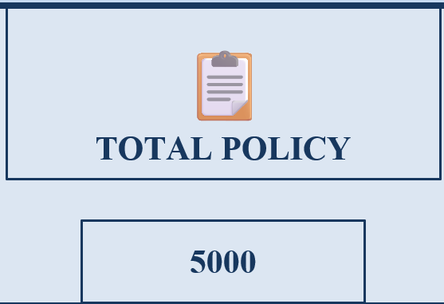
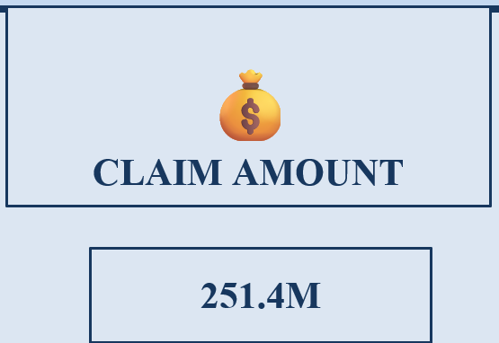
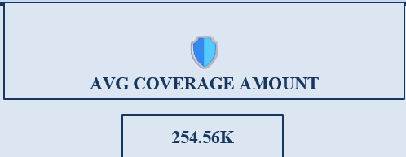
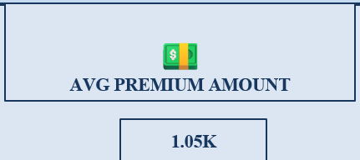
KEY PERFORMANCE INDICATORS (KPI's)
Dashboard 1 & 2 Summary
Total Customers – The dashboard contains data for 5,000 customers, providing a comprehensive view of customer demographics and policy ownership.
Total Policies – A total of 5,000 insurance policies were analyzed to evaluate policy performance and customer participation.
Claim Amount – The total claim amount processed across all policies is ₹251.4 million, reflecting the overall claims handled.
Average Coverage Amount – The average insurance coverage provided per policy is ₹254.56K, indicating the typical financial protection offered.
Average Premium Amount – The average premium collected per policy is ₹1.05K, representing the average customer payment.

Slide 16
Policy Status – Active: 1,682 Terminated: 1,678 Lapsed: 1,640 policies. Active has the highest number of policies, indicating most customers currently have active insurance coverage.
Gender-wise Policy Distribution – Male: 34% Female: 33% Other: 33%. The policy distribution is almost equal across all genders, showing balanced customer participation.
Age-wise Policy Analysis – The 48–57 age group has the highest number of policies (785), followed by 38–47 (759) and 58–67 (744). This indicates that middle-aged customers purchase the highest number of insurance policies.

Slide 17
Male vs Female Policy Count – Male: 1,705 Female: 1,640 policies. Male customers hold 65 more policies than female customers.
Policy Difference – The difference between male and female policy counts is 65 policies. This shows a small variation in policy ownership between the two groups.
Max & Min Policy Type – Highest: Health – 1,316 policies. Lowest: Auto – 1,214 policies. Health insurance is the most preferred policy type, while Auto has the lowest demand.
Year-wise Premium Trend – Premium collection was analyzed from 2014 to 2024. The trend shows fluctuations in premium amounts, with peak collections observed in the middle years before declining slightly.

Slide 18
Policy Ending Trend – Policy endings increased steadily and reached a peak of 526 policies in 2025. After 2025, the number of policy endings gradually decreased, indicating fewer policies expiring in later years.
Premium Growth Rate – Max: 38.55% Min: −0.09% Diff: 38.64%. The chart highlights yearly changes in premium growth and how performance varied over time.

Slide 19
Power BI Dashboard Overview

Slide 20
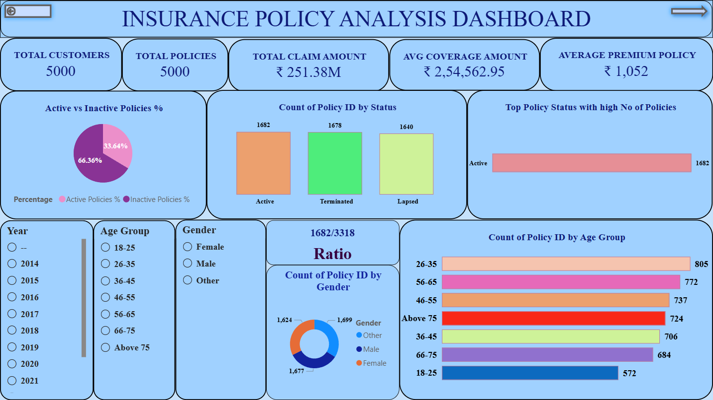
POWER BI DASHBOARD -1

Slide 21
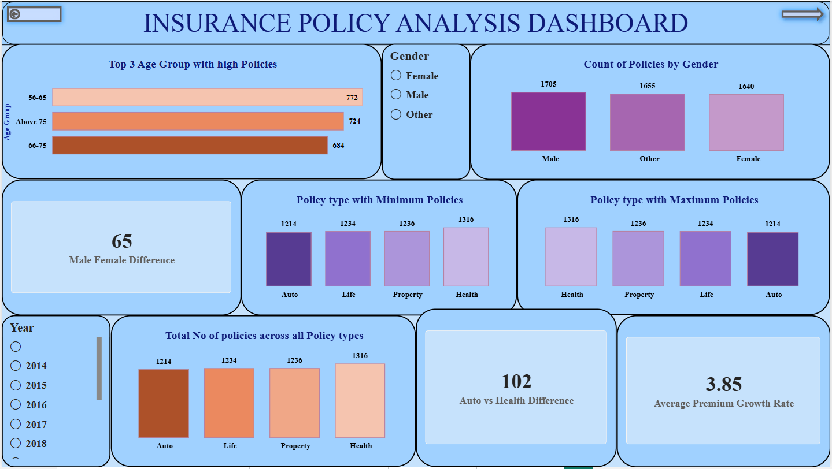
POWER BI DASHBOARD -2

Slide 22
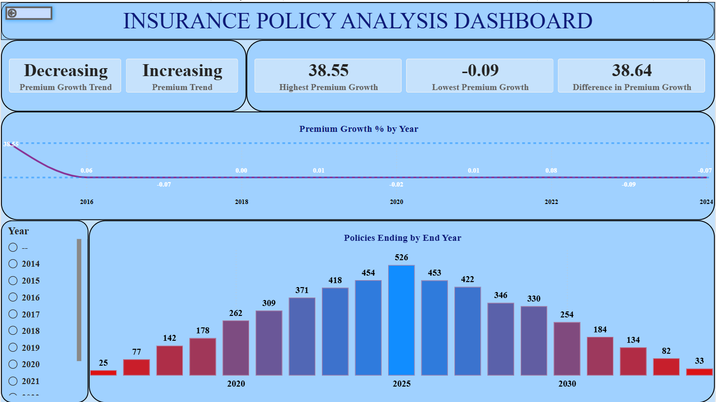
POWER BI DASHBOARD -3

Slide 23
Tableau Dashboard Overview

Slide 24
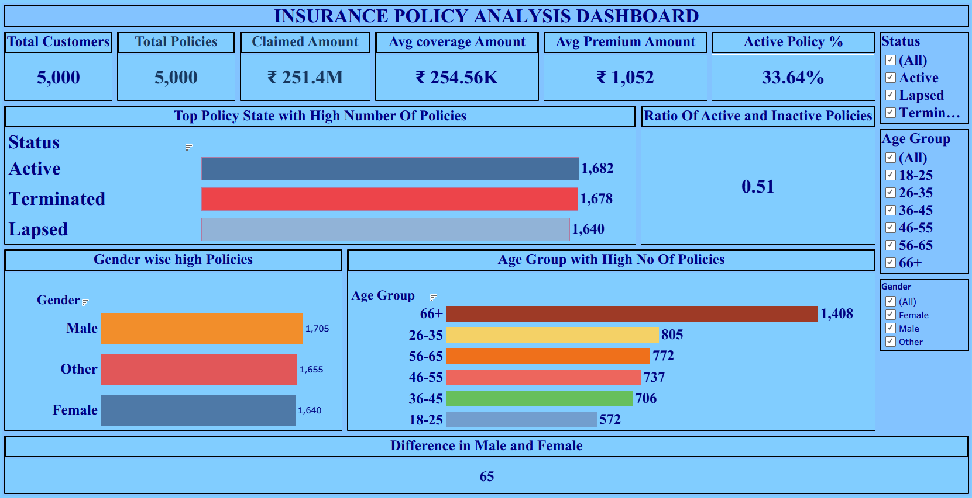
TABLEAU DASHBOARD OVERVIEW - 1

Slide 25
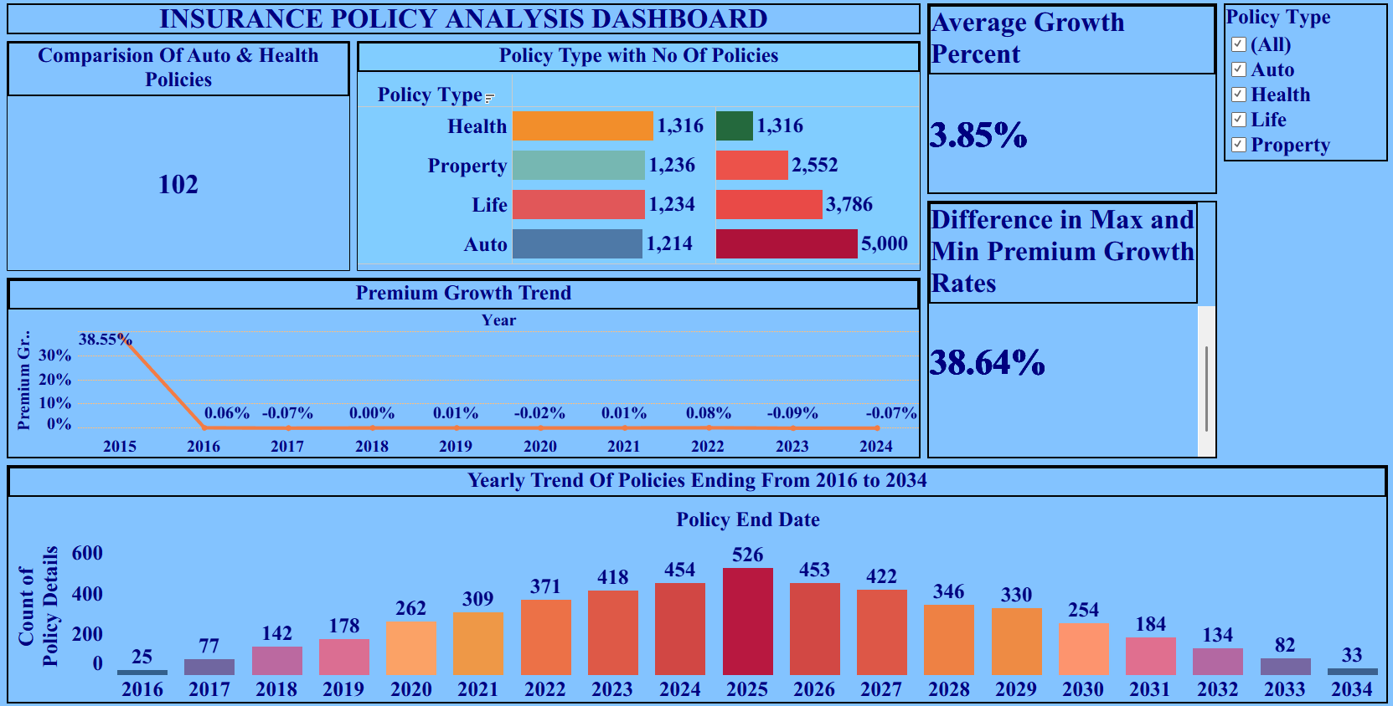
TABLEAU DASHBOARD OVERVIEW - 2

Slide 26
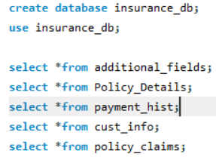
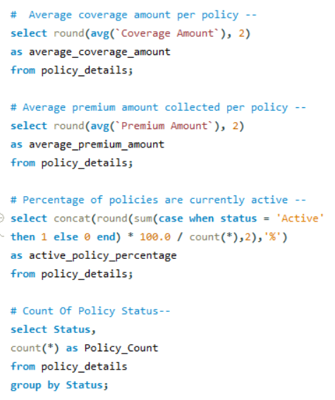


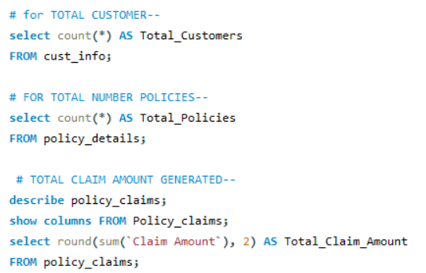





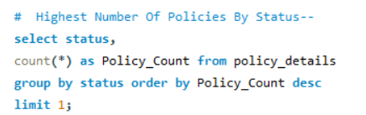

SQL QUERIES
Output
- Creating Database
-
-
-
-
-
-
-
-

Slide 27
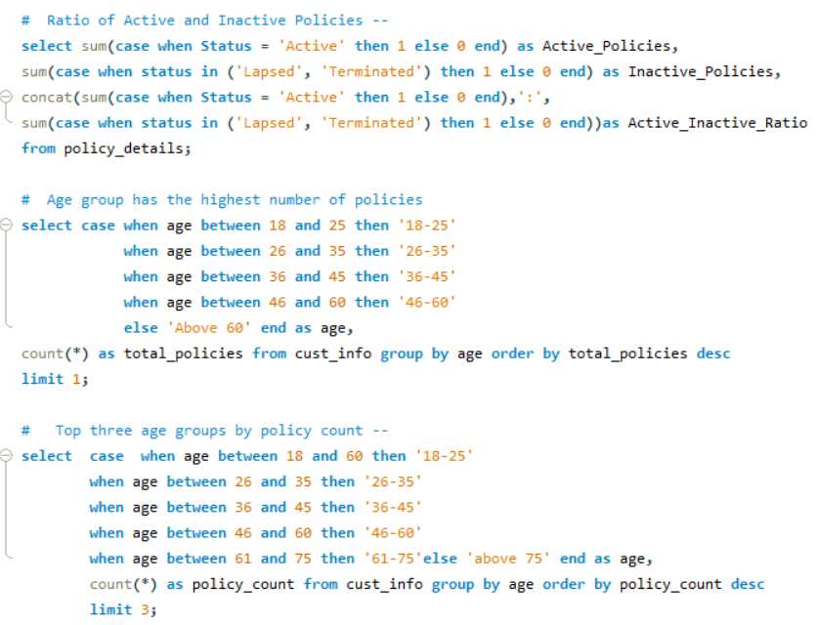


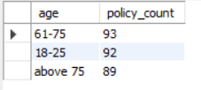
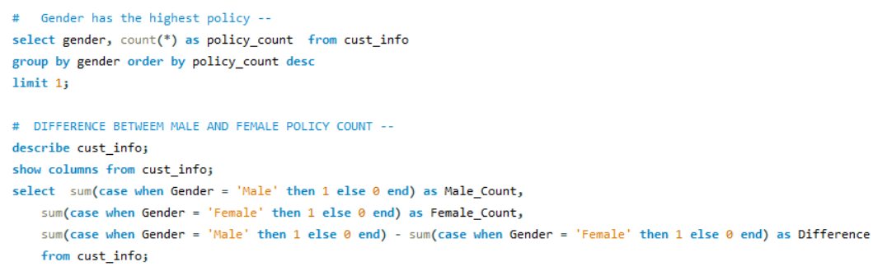


SQL QUERIES
-
-
-
-
-

Slide 28
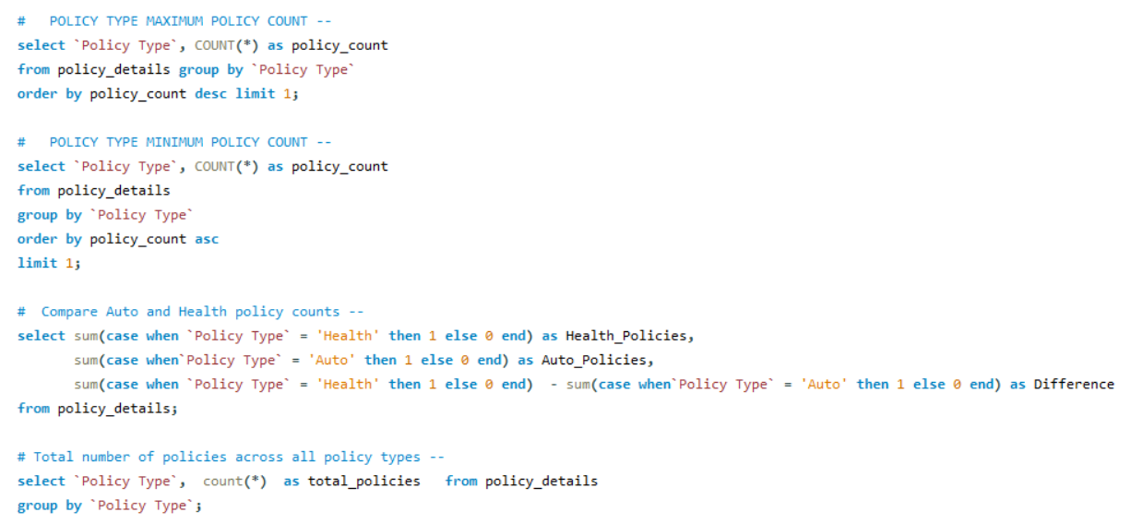



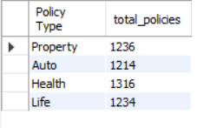
SQL QUERIES
-
-
-
-

Slide 29
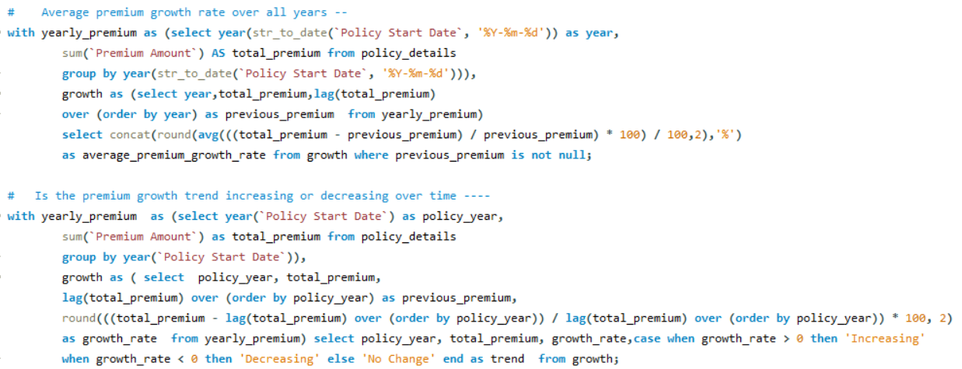

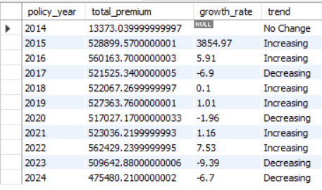
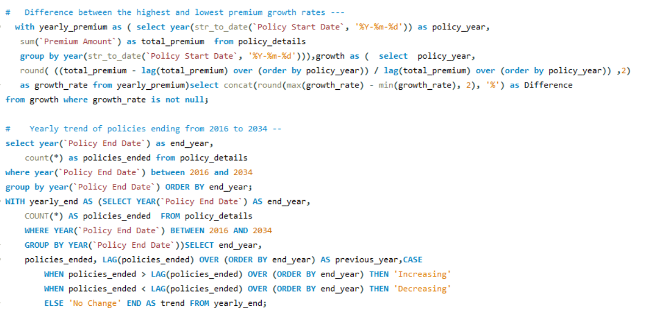

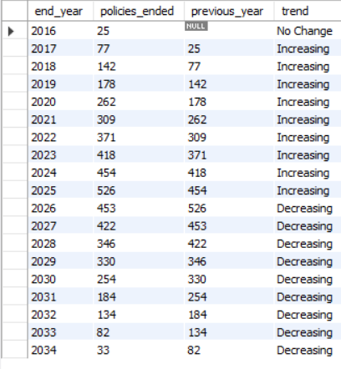
SQL QUERIES
-
-
-
-

Slide 30




🏥 Health Insurance ⭐ ⭐ (Most important for individuals)
Medical treatment can be very expensive.
It protects your savings during emergencies.
Everyone has a chance of facing health issues, regardless of age.
👨‍👩‍👧 Life Insurance ⭐ (Important when there is a dependent)
Essential if you have family members who depend on your income.
Provides financial support to your loved ones if something happens to you.
🚗 Auto Insurance
Important if you own or drive a vehicle.
Covers accident-related expenses, theft, and third-party liability.
In many countries, including India, third-party motor insurance is legally required.
🏠 Property Insurance
Important for homeowners and businesses.
Protects valuable property against fire, theft, floods, and other disasters.

Slide 31
Recommendations & Future Scope
Recommendations
Future Scope
1. Launch a Policy Renewal Program
Focus on contacting customers with lapsed and terminated policies
before their renewal period.
Send reminders through SMS, email, and phone calls to improve policy
renewals.
2. Improve Payment Success Rate
Analyze the reasons for failed payments.
Introduce multiple payment options and automated payment reminders
to reduce payment failures.
3. Speed Up Claim Settlement
Prioritize pending claims and streamline the approval process.
Faster claim settlement improves customer satisfaction and trust.
4. Target Young Customer Segments
Design affordable insurance plans for customers aged 18–24 and 35–44.
Use digital marketing campaigns to increase policy adoption among
younger customers.
1. Real-Time Dashboard Integration
Connect Power BI/Tableau directly to the live database.
Enable automatic dashboard updates without manual data refresh.
2. Predictive Analytics
Develop machine learning models to identify customers likely to lapse
or cancel their policies.
Take preventive actions to improve customer retention.
3. Branch Performance Analysis
Add branch-wise analysis to compare sales, claims, and customer
performance.
Help management identify high-performing and low-performing
branches.
4. AI-Based Product Recommendations
Recommend suitable insurance products based on customer profile
and policy history.
Increase cross-selling opportunities and enhance customer experience.

Slide 32
Conclusion : -
• Successfully analyzed insurance policy data using Excel, MySQL, Power BI, and Tableau.
• Built interactive dashboards to monitor policy performance, customer demographics, claims and premium trends.
• Generated business KPIs and actionable insights to support data-driven decision-making.
• Strengthened practical skills in data cleaning, SQL querying, visualization, and dashboard development.

Slide 33
Thank You!
Questions & Discussion

